Slide 1

Sprocket Central Pty Ltd
Data analytics approach

Slide 2
Agenda
We’ll use three stages:
Data Exploration
Model Development
Interpretation

Slide 3
Agenda
Approach for Data analysis :
Age distribution
Gender
Bike purchase
Job industry
Car ownership
Wealth distribution

Slide 4
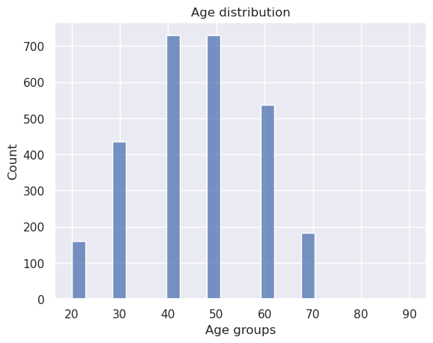
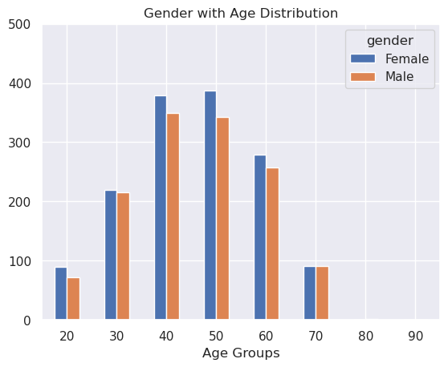
Data Exploration : Age Distribution & Bike Purchases
Customers are more from the age group of 40s , followed by 50s & 60s.
Fewer customer are from 10-19 & 80-99 for obvious reasons.
Data shows age group 40-50 and 50-60 have high count in terms of bike related purchases in last 3 years with a slightly greater female ratio.
The target audience for our marketing and advertising should be inclined on females than males.

Slide 5
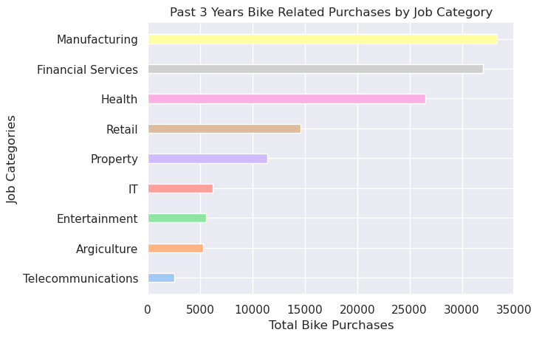
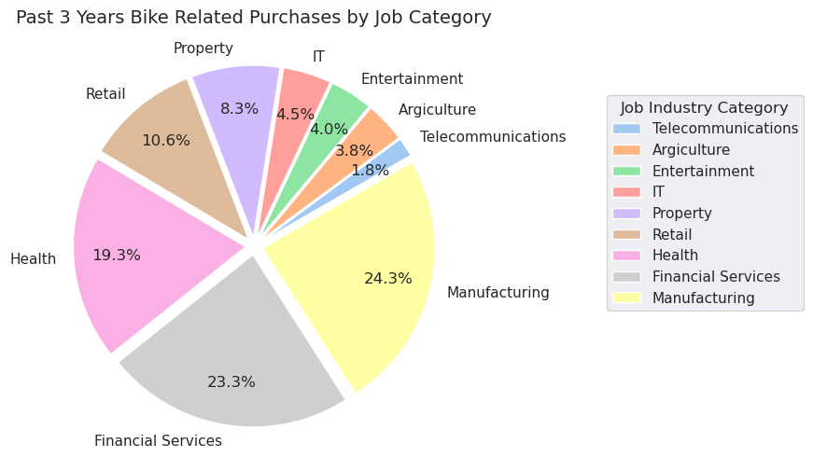
Data Exploration : Job Industry
Financial Services, Manufacturing, and Health are the top three profit-generating industries, followed by retail and property.

Slide 6
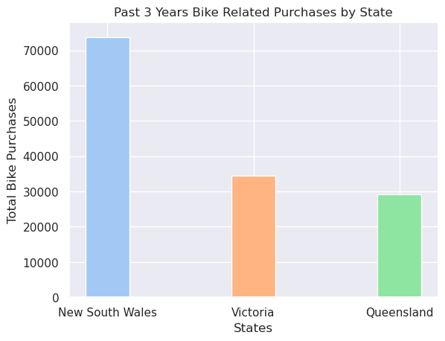
Data Exploration : State
New south wales has the highest number of bike purchases amongste the three states

Slide 7
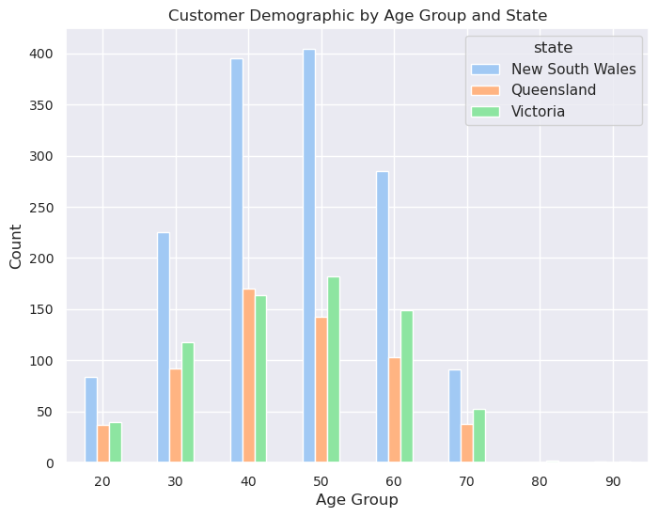
Data Exploration : Customers
It is evident that New south wales has the highest number of customers across all the age groups.

Slide 8
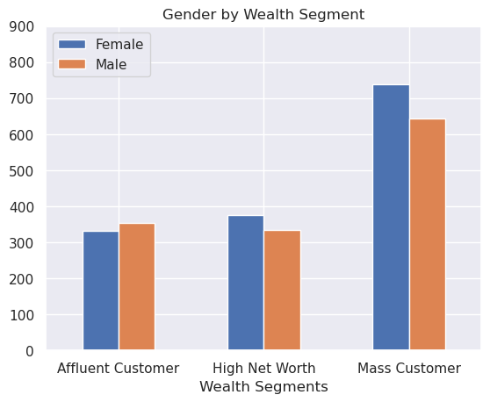
Data Exploration : Wealth
Customers in the wealth segment of Mass are the majority with females edging the males.
Affluent customers and High net worth customers have almost similar numbers

Slide 9
Model Development
CUSTOMER CLASSIFICATION – Targeting High Value Customers
The following are the high-value clients to target :
Aged between 40 – 60.
Most of the high value customers are female compared to male
Working in Financial Service, Manufacturing and Health.
Who are currently living in New South Wales and Victoria.
Wealth with the focus on mass customers

Slide 10
Note: The data and information in this document is reflective of a hypothetical situation and client. This document is to be used for KPMG Virtual Internship purposes only.
THANK YOU

